Slide 1
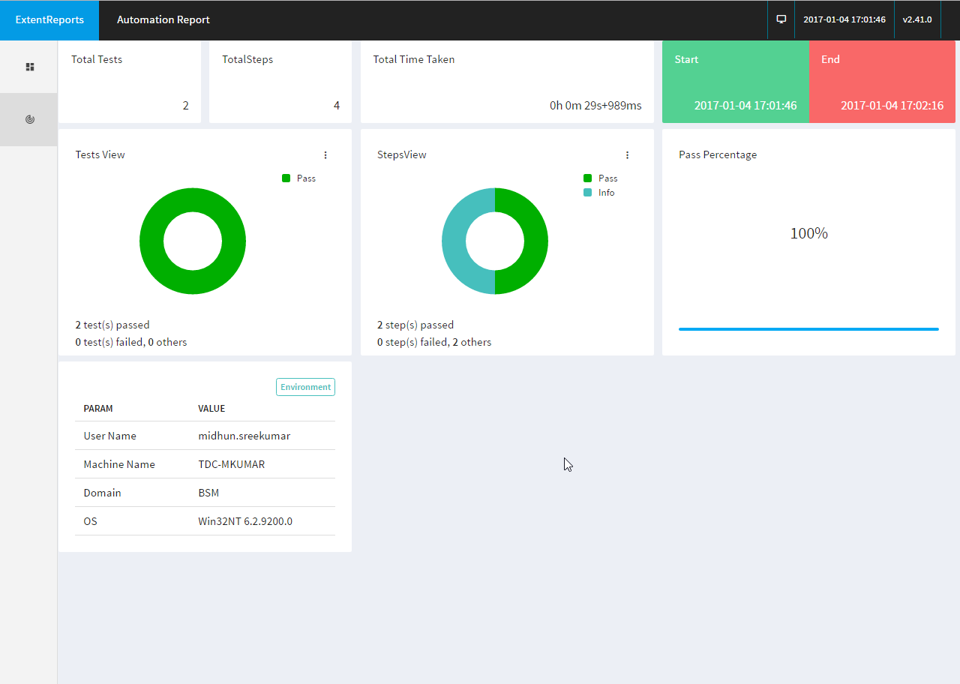
Spring boot Application
REST Request
REST Interface (/trigger)
Mongo DB
Automation framework
Cucumber
Selenium
TestNG
Extent Reporting Dashboard
Test Runner
Test & Operations
Listener Service
Extent Reporter
Feature Files
Web Drivers
TestNG Methods
Page Object Model
Listener Service
Step Definition
PDF Reporter

